Slide 1

MBDS Capstone Project: Kick-Off, Sep 25 Intake
Dae-Jin Lee, PhD.
E-mail: daelee@faculty.ie.edu

Slide 2

Why is the capstone project one of the most important parts of your journey?

Slide 3
Key points
Integration of Knowledge
Uses all the skills and tools learned in the program.
Real-World Problem Solving
Solves real business challenges using advanced data analytics.
Teamwork Skills
Builds collaboration and group dynamics.
Industry Experience
Work directly with companies and learn from them.
Career Boost
Impress employers.
Innovation and Impact
Create solutions that make a difference.

Slide 4
Projects
Which options do you have?

Slide 5
Corporate project
Objective: Address real-world business challenges presented by partner companies.
Process:
Define a business problem and propose a data-driven solution.
Use suitable data science /ML/AI models and methodologies.
Present findings and solutions with clarity and creativity.
Structure:
Work in groups of five.
Receive mentorship from an academic tutor and a company mentor.
Deliverables include an executive summary, written report, a poster and a final presentation.

Slide 6
Timelines
When will things happen?

Slide 7

April 13 2026
Timelines
April 14 2026
May 2026
June 29 2026
July 7 2026
Kick-Off Presentation
-Companies Presentations
-Submission of Preferences
-Groups Created
-Academic Tutor Assigned
-Starting the Capstone
-8 weekly Meetings with the Tutors
Submission
Panel Presentation

Slide 8
Course Objectives
What should you do?

Slide 9

Course Objectives
Demonstrate their proficiency in tackling real-world business challenges through data-driven analytics.
Precisely identifying and analyzing the business challenge or problem, followed by proposing a solution grounded in data analytics./ML/AI
Choosing the most suitable data science model ML/AI algorithms and methodology to effectively address the problem while considering the trade-offs among various solutions.
Creating a sustainable architecture that supports the selected model.
Developing a proof of concept utilizing real-world data and employing the tools and techniques learned throughout the program.
Effectively presenting their proposal and findings to a panel with clarity and precision.
Acknowledging and addressing any ethical or legal implications associated with their proposed solution.

Slide 10
Course Methodology
How are we going to organize?

Slide 11

Course Methodology
Integrated Instruction: The curriculum includes a blend of Masterclasses and team-based project work, supplemented by dedicated mentoring sessions.
Supportive Academic Tutoring: 8 weekly sessions are structured to offer substantial support and insight, aiding students in advancing their project development.
Evaluation Milestones: Projects culminate in a formal presentation, critically assessed by a panel of professors. (date: ~July 7, 2026).
Quality Assurance Checkpoint: A preparatory review will be coordinated with the partner organization to ensure the project's alignment with business objectives.
Approval for Presentation: Both the academic tutor and the organization's mentor must confirm the project meets a set standard of quality prior to presentation.
Collaborative Learning: Students will be organized into teams of 4-5 to address real-world business challenges provided by partnering organizations.

Slide 12
Deliverables
What should you deliver?

Slide 13

Deliverables
Written Report: min 10 pages. max 20 pages. 1.0 spacing and 12-point Times New Roman. (29 June, 2026)
Poster: pdf A0 format (29 June, 2026)
Final Presentation: by 23:59 (Madrid time) on the day before your final presentation (July 6, 2026)
Slides prepared for 15’ presentation.
Code: repository on github (accessible notebook)
Ethics statement: in the cover page

Slide 14

Final Report
Objective: Define the problem and the aim of the work.
Data Sources: Detail the data used, including preparation and processing, and the acquisition of any additional data.
Methodology: Describe the tools, processes, and technology employed in problem-solving.
Potential Solutions: Present at least two considered alternatives, explaining the rationale for the chosen solution.
Development: Include the code, adhering to standard practices for clarity and understanding by field specialists.
Conclusions: Summarize the final result from a technical standpoint, encompassing metrics like algorithm choice and precision, and discuss its impact and practicality for business implementation.

Slide 15


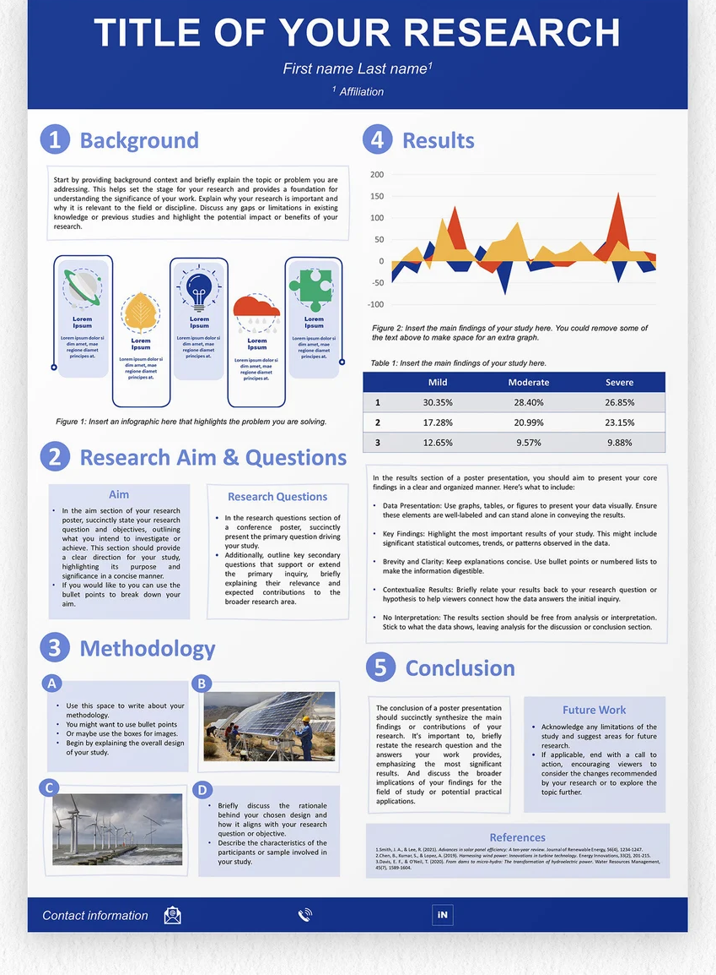
Poster presentation

Slide 16
Poster presentation
Clear Communication: Summarize key insights quickly and effectively.
Visual Storytelling: Showcase data and solutions through strong visuals.
Real-World Simulation: Practice business-style, executive-level presentations.
Interactive Engagement: Discuss, explain, and defend work dynamically.
Immediate Feedback: Gain insights from diverse viewers instantly.
Portfolio Material: Create a professional artifact for interviews and networking.
Confidence Building: Strengthen public speaking and adaptive thinking.

Slide 17
Evaluation Criteria
How you will be evaluated?

Slide 18

Evaluation Criteria
Individual Academic Tutor feedback: 40%
Project report and presentation: 60% (2 academics / professors and company mentor). Half of the 60% is individual and half is group.
Originality of the work and relevance of the proposed contribution: 25%
Methodological rigor and justification of the decisions made: 25%
Coherence, quality, and clarity in the written, oral, and visual presentation: 25%
Critical analysis and ability to defend the results in front of the evaluation committee: 25%

